Slide 1

Healthcare Analytics For Doctors Visits TIRTC
Ankitha M

Slide 2

PROBLEM STATEMENT
Analyzing patients visit to identify which groups visit doctors more frequently. Explore how illness, health status and chronic conditions relate to visit patterns. Provide data-driven insights to help hospital management improve healthcare services.

Slide 3
PROJECT DESCRIPTION
This project focuses on executing exploratory data analysis and predictive modeling on a comprehensive healthcare dataset. The main goal is to uncover hidden relationships between patient demographic profiles, health status variables, and insurance types to understand what drives healthcare utilization. By identifying these patterns, the project provides actionable insights to help healthcare providers optimize patient care strategies, allocate resources efficiently, and improve overall operational decision-making.

Slide 4

WHO ARE THE END USERS?
Doctors and Healthcare professionals
Public health organizers
Hospital management and administrators

Slide 5

Technology Used
  Python
  Pandas
  Numpy
  Matplotlib
  Sea born
  Google Colab

Slide 6
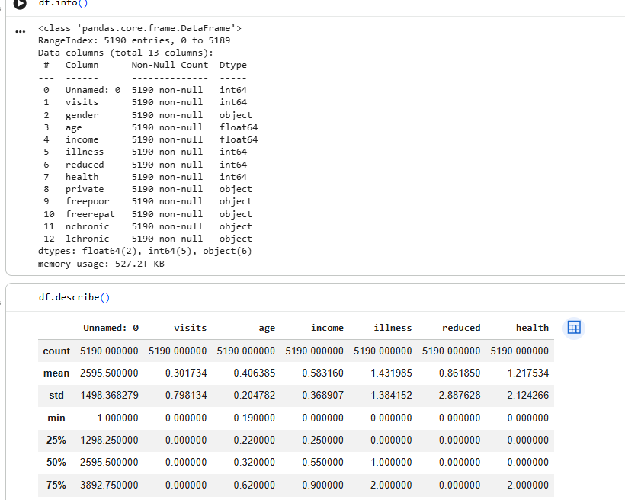
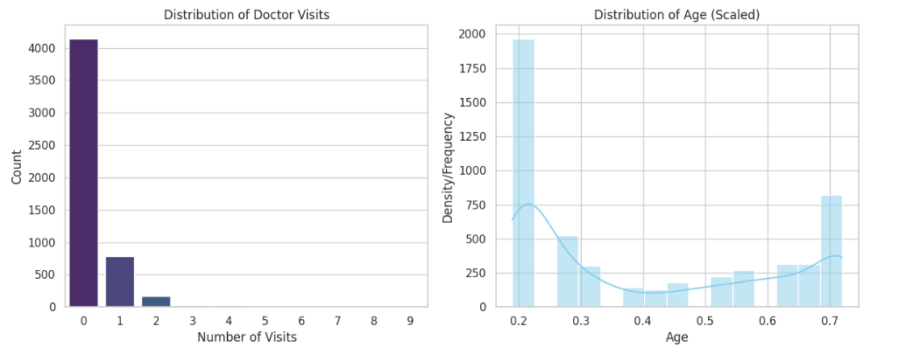
RESULTS
[Add screen shots of your code ]

Slide 7
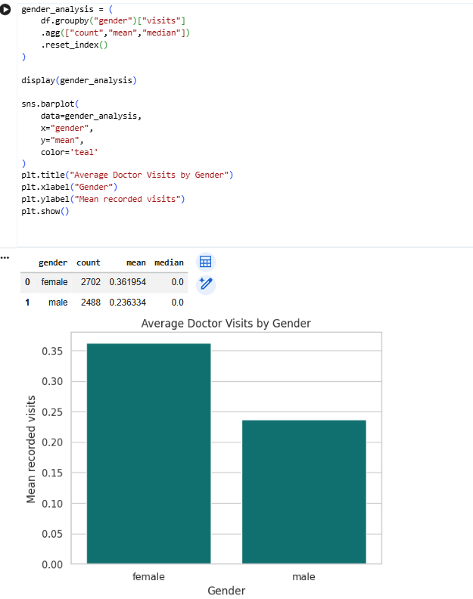
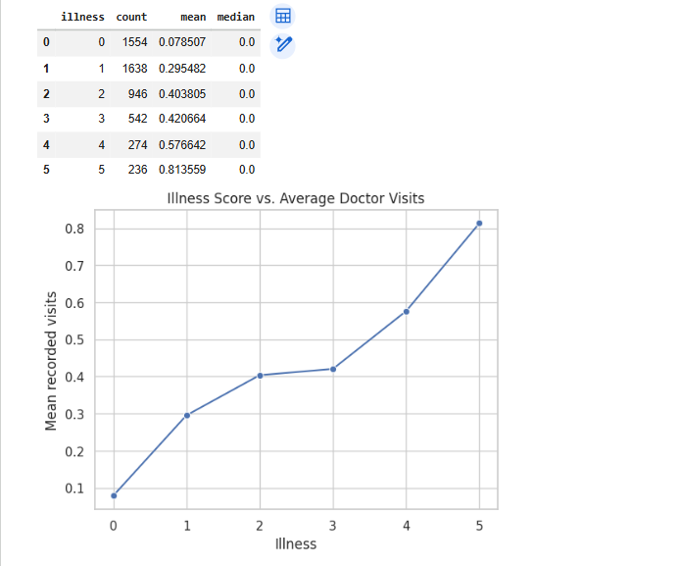

Slide 8
Thank you
https://github.com/ankitha122004-art/Healthcare-Analytics-For-Doctors-Visits-TIRTC/
.
.

